Slide 1
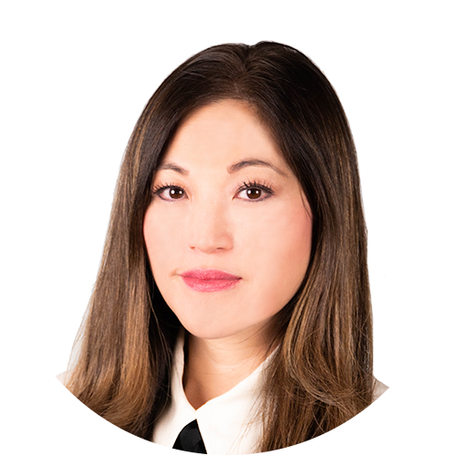
Dr. Alina K. Fong, Ph.D.
Co-Founder, Clinical Neuropsychologist, Clinical Director of Cognitive FX

Slide 2
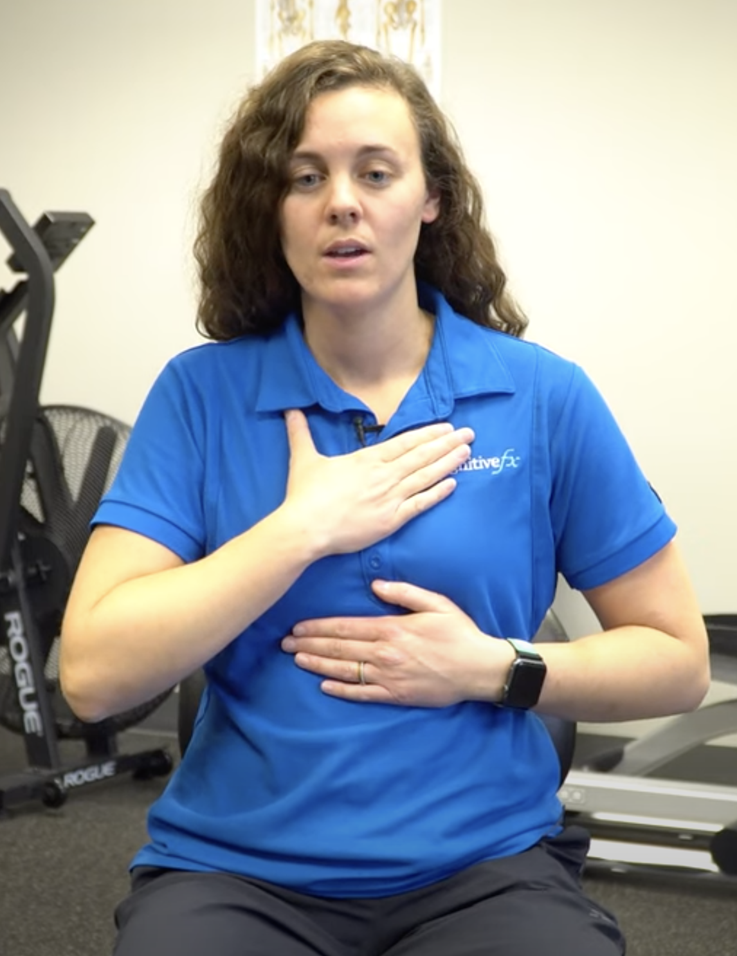
Breathing Exercise
Extended Exhale Breathing:
Place one hand across the base of your ribs at your sternum.
Place the other hand across the top of your chest
You want your upper hand on your chest to not move much
You want your lower hand on the base your ribs to move the most.
Start breathing in for 7 seconds
Hold your breath for 3 seconds
Slowly exhale for as long as you can
Repeat steps 3 through 5 for about 2 or 3 repetitions.

Slide 3
Other breathing techniques exercises
Box breathing:
Breathe in for 5 seconds, hold for 5 seconds, breathe out for 5 seconds and repeat.
Regulated breathing:
Sit in a comfortable position and practice breathing evenly in and out for 5 minutes. Make sure stomach muscles are relaxed.
Mustache Breathing
Sit in a comfortable position, place your finger under your nose, breathe in and out through your nose slowly so that you cannot feel the air brush your finger. Do this for about 1 minute. Rest and then repeat.

Slide 4
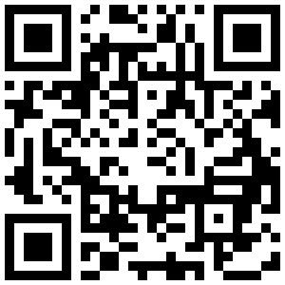
Contact us and Learn more
by scanning this code

